Slide 1
account-flow
Alice's transaction consists of 5 instructions.
1. create empty account owned by token program
2. initialize empty account as Alice's X token account
3. transfer X tokens from Alice's main X token account to her temporary X token account
4. create empty account owned by escrow program
5. initialize empty account as escrow state and transfer temporary X token account ownership to PDA

Slide 2
Solana blockchain
Escrow program
System program
Token program
Alice’s X token ac
Alice’s main ac
Alice’s Y token ac

Slide 3
Solana blockchain
Escrow program
Empty ac owned by
the token program
2.sure
System program
Token program
1. Hi system program please create a new acct that is owned by the token program
Alice’s X token ac
Alice’s main ac
Alice’s Y token ac

Slide 4
Solana blockchain
Escrow program
Empty ac owned by
the token program
System program
Token program
Hi token program see that new acct over there? Please initialize it
Alice’s X token ac
Alice’s main ac
Alice’s Y token ac

Slide 5
Solana blockchain
Escrow program
System program
Alice’s X token ac
Token program
sure
Alice is the owner of the multiple token acct of the same token
Alice’s X token ac
Alice’s main ac
Alice’s Y token ac

Slide 6
Solana blockchain
Escrow program
System program
Alice’s X token ac
Token program
Hi token program please transfer <amnt> X tokens from this to this acct
Alice’s X token ac
Alice’s main ac
Alice’s Y token ac

Slide 7
Solana blockchain
Escrow program
Empty acct owned by
escrow program
2. sure
System program
Alice’s X token ac
Token program
1. Hi system program please create another acct for escrow program
Alice’s X token ac
Alice’s main ac
Alice’s Y token ac

Slide 8
Solana blockchain
Escrow program
Empty acct owned by
escrow program
Alice’s X token ac
System program
Hi escrow program please initialize escrow .
Here are the tokens I want to sell .
This is the acct you can use to write state into.
Token program
Alice’s X token ac
Alice’s main ac
Alice’s Y token ac

Slide 9
Solana blockchain
Escrow program
1. writing state
2. Hi token program please give my PDA ownership of this
acct.
Alice signed the tx so its cool with her
Initialized acct owned by
the escrow program
Alice’s X token ac
System program
Token program
Alice’s X token ac
Alice’s main ac
Alice’s Y token ac

Slide 10
Solana blockchain
Escrow program
Initialized acct owned by
the escrow program
PDA’s token ac
System program
Hold state:
is_initialized
initializer_pubkey
Temp_token_acct_pubkey
Receiveing token acct pubkey
expected amnt
Token program
Alice’s X token ac
Alice’s main ac
Alice’s Y token ac

Slide 11
Note:-
There can be several instructions(ix) inside one transaction(tx).
Multiple instructions can run synchronously and can call different program.
Transactions are atomic either all or none. If a single instruction fails, the entire transaction fails.
Instructions may depend on previous instruction

Slide 12
note
The system program is responsible for creating account space (but not internal user space) and assigning account ownership

Slide 13
note
1. create empty account owned by token program
2. initialize empty account as Alice's X token account
3. transfer X tokens from Alice's main X token account to her temporary X token account
4. create empty account owned by escrow program
5. initialize empty account as escrow state and transfer temporary X token account ownership to PDA

Slide 14
In the js library world, an Account has a double meaning and is also used as the object to hold a keypair.

Slide 15
Acct creation → initialization to user space owner

Slide 16
There are a couple of things that were left out - to keep things simple - but should definitely be added for a real program. First, the maximum token amount is U64_MAX which is higher than javascript's number value. Hence, you need to find a way to handle this, either by limiting the allowed amount of tokens that can be put in or by accepting the token amount as a string and then using a library like bn.js to convert the string. Secondly, you should never have your users put in a private key. Use an external wallet like solong or the sol-wallet-adapter library. You'd create the transaction, add the instructions, and then ask whatever trusted service you're using to sign the transaction and send it back to you. You can then add the other two keypair accounts and send off the tx to the network. No other program can fake this PDA because it is the runtime that sees which program is making the invoke_signed call. Only the escrow program will have the programId that will result in a PDA equal to one of the addresses in invoke_signed's accounts argument.

Slide 17
In the js library world, an Account has a double meaning and is also used as the object to hold a keypair.

Slide 18
No other program can fake this PDA because it is the runtime that sees which program is making the invoke_signed call. Only the escrow program will have the programId that will result in a PDA equal to one of the addresses in invoke_signed's accounts argument.

Slide 19
Now we can see why we had to check whether the escrow state account was rent-exempt. If we had't and Alice were to pass in a non-rent-exempt account, the account balance might go to zero before Bob takes the trade. With the account gone, Alice would have no way to recover her tokens.

Slide 20
Since the temp token account is owned by the token program, only the token program may decrease the balance. And because this action requires permission of the (user space) owner of the token account (in this case the PDA), we use invoke_signed again.
To conclude this function and the program, we can do the same with the escrow state account.
msg!("Closing the escrow account...");
**initializers_main_account.lamports.borrow_mut() = initializers_main_account.lamports()
.checked_add(escrow_account.lamports())
.ok_or(EscrowError::AmountOverflow)?;
**escrow_account.lamports.borrow_mut() = 0;
*escrow_account.data.borrow_mut() = &mut [];
Ok(())

Slide 21
Note that we are also setting the data field equal to an empty slice. Why is this necessary if the account is purged from memory after the transaction anyway?
It is because this instruction is not necessarily the final instruction in the transaction. Thus, a subsequent transaction may read or even revive the data completely by making the account rent-exempt again. Depending on your program, forgetting to clear the data field can have dangerous consequences.
In any call to a program that is of the "close" kind, i.e. where you set an account's lamports to zero so it's removed from memory after the transaction, make sure to either clear the data field or leave the data in a state that would be OK to be recovered by a subsequent transaction.

Slide 22
Now we can see why we had to check whether the escrow state account was rent-exempt. If we had't and Alice were to pass in a non-rent-exempt account, the account balance might go to zero before Bob takes the trade. With the account gone, Alice would have no way to recover her tokens.

Slide 23
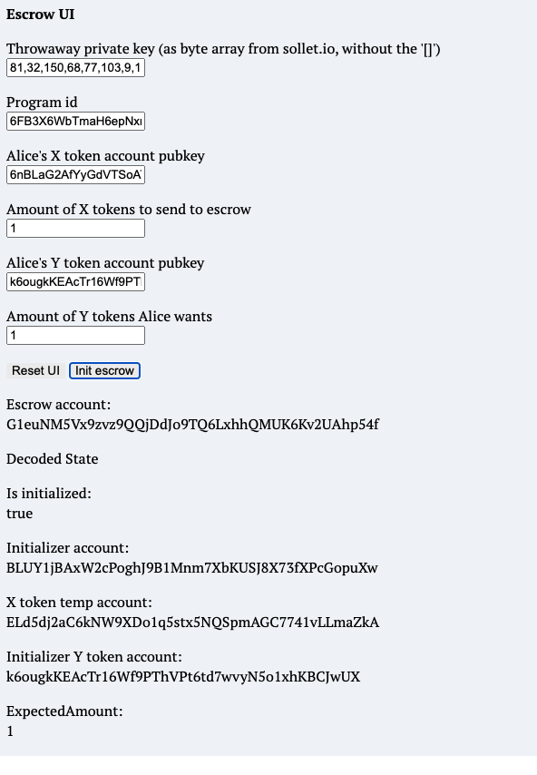
Solana blockchain

Slide 24
We check that Alice's Y token account is owned by the token program but what we don't check is that the given account is actually a token account. It could also be a token mint account. This is not a critical bug because Bob's tx will simply fail (when the program tries to transfer his Y tokens to a mint account) but for the same reasons as the check for correct program ownership we should add this check in Alice's ix.

Slide 25
const initEscrowIx = new TransactionInstruction({
programId: escrowProgramId,
keys: [
{ pubkey: initializerAccount.publicKey, isSigner: true, isWritable: false },
{ pubkey: tempTokenAccount.publicKey, isSigner: false, isWritable: true },
{ pubkey: new PublicKey(initializerReceivingTokenAccountPubkeyString), isSigner: false, isWritable: false },
{ pubkey: escrowAccount.publicKey, isSigner: false, isWritable: true },
{ pubkey: SYSVAR_RENT_PUBKEY, isSigner: false, isWritable: false},
{ pubkey: TOKEN_PROGRAM_ID, isSigner: false, isWritable: false },
],
data: Buffer.from(Uint8Array.of(0, ...new BN(expectedAmount).toArray("le", 8)))
})
The 5th and final ix - where we initiate the escrow - is more interesting since here we get almost no help from the Solana libraries. We manually create the instruction by calling its constructor (new TransactionInstruction...). The required format should feel familiar! It's exactly what our program entrypoint expects. We pass in the programId of our escrow program and then the keys. Here, we specify whether a given account will sign the tx - if it then doesn't the tx will fail - and whether an account is read-only - if it's then written to the tx will fail. Finally, we specify what will arrive at the entrypoint as instruction_data. We start with a 0 since the first byte is what we used in instruction.rs as a tag to determine how to decode the instruction. 0 means InitEscrow. The next bytes will be the expected_amount. We use the bn.js library to write our expected amount as an 8-byte array of little-endian numbers. 8 bytes because inside instruction.rs we decode a u64 and little-endian because we decode it the slice with u64::from_le_bytes. We use a u64 because that's the max supply of a token (opens new window).

Slide 26
Mapping of front end to back end

Slide 37
Solana blockchain
Escrow program
System program
Alice’s X token ac
Token program
Alice’s X token ac
Alice’s main ac
Alice’s Y token ac

